Slide 1
Atomization energy prediction : descriptor for molecules based on Coulomb’s Law
Machine Learning and Data Mining
Anton Zaitsev – Papadimitriou Emmanouil F.

Slide 2
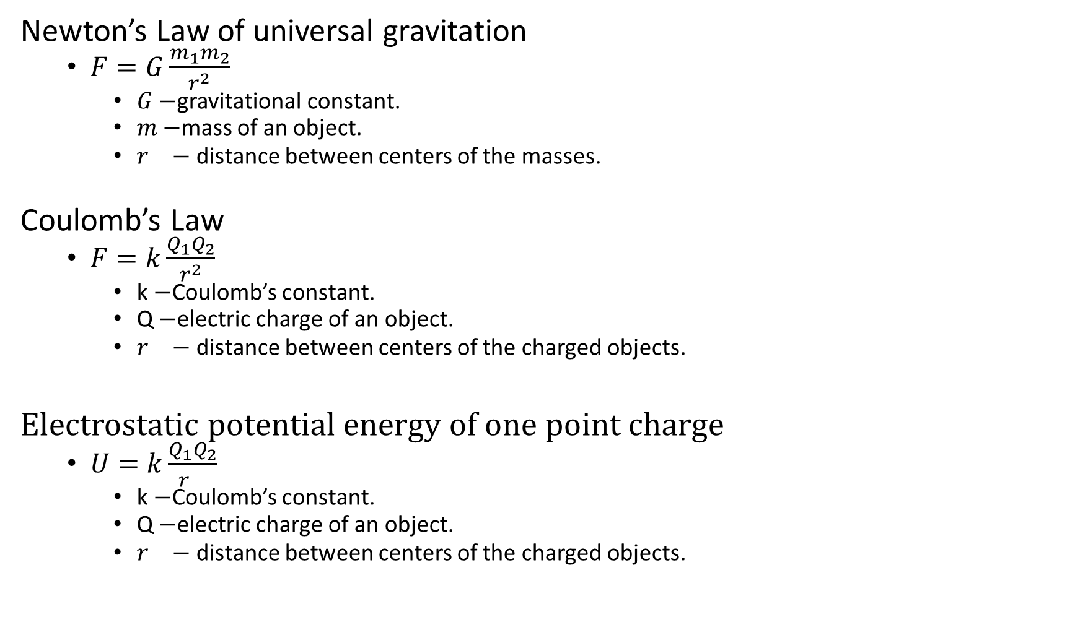
Link between the laws of attraction
Newton’s Law of universal gravitation
  $F=G\frac{m_{1}m_{2}}{r^{2}}$
    $G−$gravitational constant.
    $m−$mass of an object.
    $r^{}−$ distance between centers of the masses.
Coulomb’s Law
  $F=k\frac{Q_{1}Q_{2}}{r^{2}}$
    k $−$Coulomb’s constant.
    Q $−$electric charge of an object.
    $r^{}−$ distance between centers of the charged objects.
Electrostatic potential energy of one point charge
  $U=k\frac{Q_{1}Q_{2}}{r^{}}$
    k $−$Coulomb’s constant.
    Q $−$electric charge of an object.
    $r^{}−$ distance between centers of the charged objects.

Slide 3
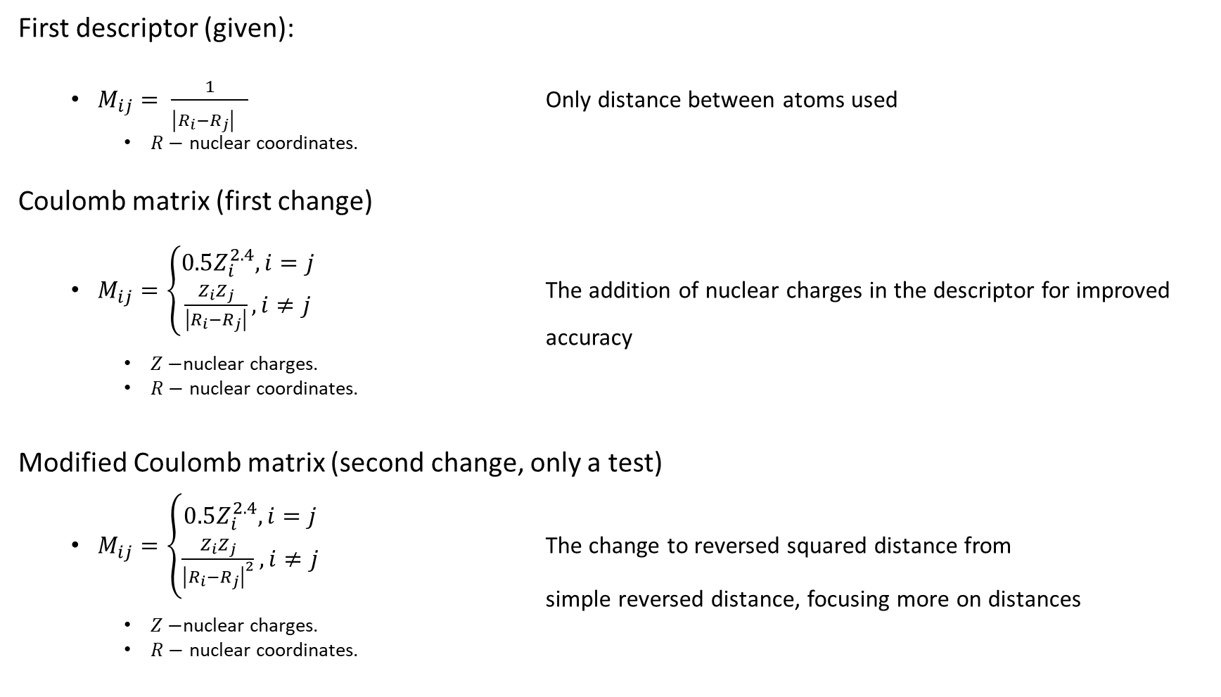
Descriptor choice (for qm7x dataset analysis)
First descriptor (given):
  $M_{ij}= \frac{1}{{\left|R_{i}−R_{j}\right|}^{}}$ Only distance between atoms used
    $R−$ nuclear coordinates.
Coulomb matrix (first change)
  $M_{ij}=\left\{\begin{aligned}0.5Z_{i}^{2.4}, i=j \\ \frac{Z_{i}Z_{j}}{\left|R_{i}−R_{j}\right|}, i≠j\end{aligned}\right.$ The addition of nuclear charges in the descriptor for improved accuracy
    $Z−$nuclear charges.
    $R−$ nuclear coordinates.
Modified Coulomb matrix (second change, only a test)
  $M_{ij}=\left\{\begin{aligned}0.5Z_{i}^{2.4}, i=j \\ \frac{Z_{i}Z_{j}}{{\left|R_{i}−R_{j}\right|}^{2}}, i≠j\end{aligned}\right.$ The change to reversed squared distance from simple reversed distance, focusing more on distances
    $Z−$nuclear charges.
    $R−$ nuclear coordinates.

Slide 4
What changed?
Before:
  Calculate pair-wise distances between atoms, get distance matrix.
  Pad each distance matrix with zeros until the maximum size of the matrix is reached (maximum number of atoms)
Now:
  Create zeros matrix of the maximum size (maximum number of atoms).
  Calculate distances between atoms (squared), get distance matrix.
  Calculate charges matrix by multiplying charges of atoms with each other.
  Divide charges matrix by the distance matrix.
    Get energy of columbic repulsion between different pairs of nuclei in the molecule.
  For the diagonal, compute exponential fit of the potential energies of the isolated atoms.
    Empirically chosen by the original developers of Coulomb matrices.

Slide 5
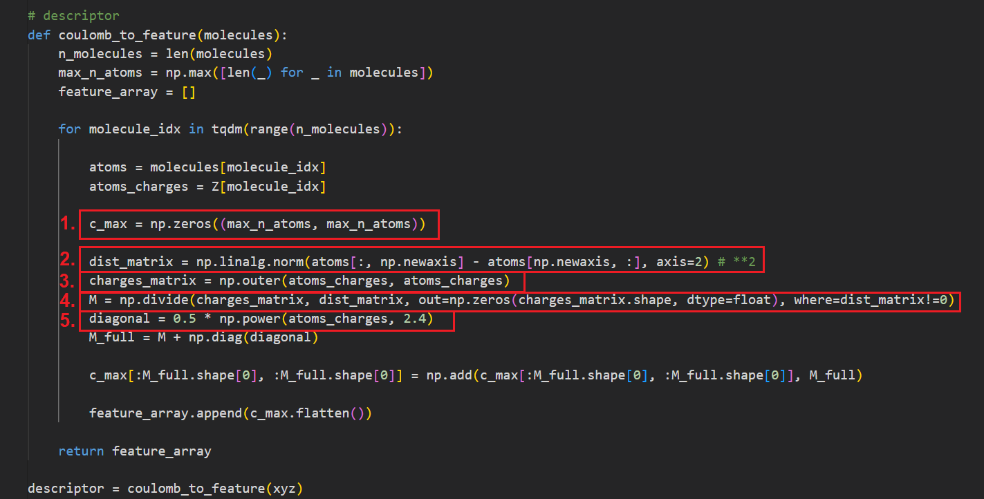
What changed?
  Create zeros matrix of the maximum size
  Calculate distances between atoms (squared), get distance matrix.
  Calculate charges matrix by multiplying charges of atoms with each other.
  Divide the charges matrix by the distance matrix.
  For the diagonal, compute exponential fit of the potential energies of the isolated atoms.

Slide 6
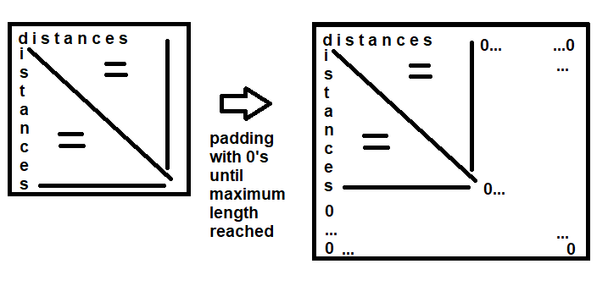
What changed?

Slide 7
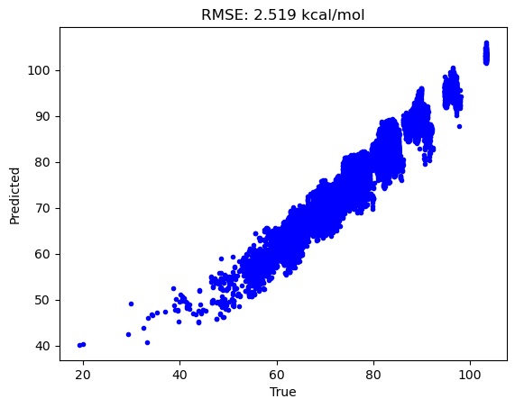
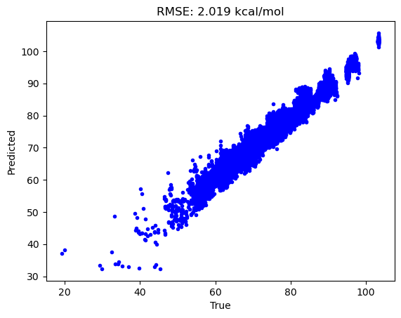
Result comparison
Original descriptor
Coulomb matrix representation, Euclidian distance

Slide 8

Result comparison
Original descriptor
Coulomb matrix representation, Euclidian distance squared

Slide 9
Thank you for your attention

